Slide 1
Some specifics about including tagging data into stock synthesis
Ian Taylor
IATTC Shark Assessment Workshop
2 November 2009

Slide 2
Stocks in Stock Synthesis
Fundamentally Age-structured
Distribution of lengths computed for
each age
Other population divisions include
spatial area and growth pattern
Tag group is an additional identifier for a subset of the population

Slide 3
Characteristics of tag groups
(TG) in Stock Synthesis
Year and season of release
Release area
Gender (female, male, or unsexed)
Age at release
Number of releases

Slide 4
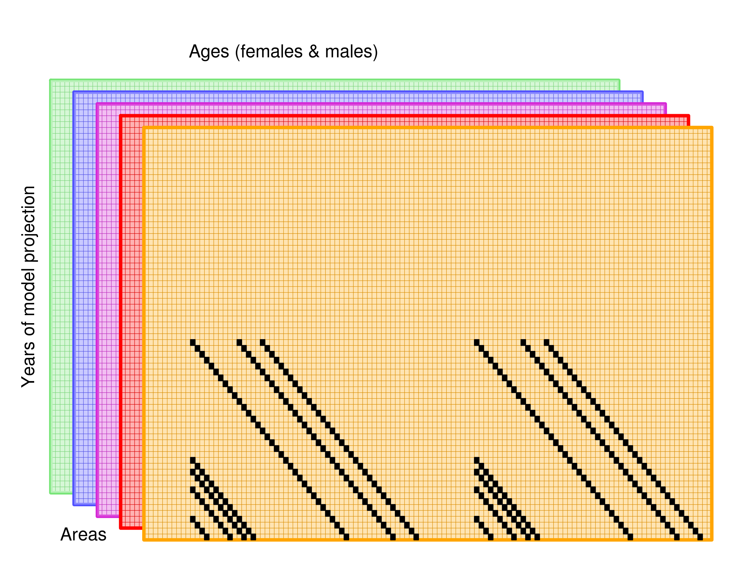
releases at different ages
within same year

Slide 5
Recapture Data in Stock Synthesis
For each tag recapture event:
  TG, Year, Season, Fleet, N recaptures
  Fleet is specific to an area, so no need to read area of recapture
  Age is known from the assigned age at release and the elapsed time

Slide 6
Parameters for each tag type
Initial tag loss (tag-induced mortality)
Chronic Tag-loss rates (tag shedding)
Tag-reporting rates
  by group
  could be more flexible
Tags assigned fleet for release & fleet for recapture
Assign recapture events into 3darray:
  TG, the tag group
  F, fleet doing the recapture event
  TG_t, elapsed time (in count of seasons) since release

Slide 7
Tag Captures and Survival
Recap(TG,f,TG_t) +=
  TG_alive(p,g)
  * Sel_a(t,g,f,a1)*Hrate(t,f)
  / (Z_rate(t,p,g,a1)+TG_loss(TG))
  *(1.-mfexp(-seasdur(s)*(Z_rate(t,p,g,a1)+TG_loss(TG))))
  * TG_report(f)
  Where TG_t is a counter to index the time period of recaptures, it increments with passage of each season
  Then do survival:
  TG_alive(p,g)*= mfexp(-seasdur(s)*(Z_rate(t,p,g,a1)+TG_loss(TG)));

Slide 8
Tag Movement Between Areas at End of Each Season
TG_alive_temp=TG_alive; // has (p,g) dimensions
TG_alive=0.0;
for (g=1;g<=gmorph;g++)
if(use_morph(g)>0)
{
for (p=1;p<=pop;p++) // source population
for (p2=1;p2<=pop;p2++) // destination population
{
k=move_pattern(s,g,p,p2); // does movement occur?
if(k>0) TG_alive(p2,g) += TG_alive_temp(p,g)*migrrate(y,k,a1);
}
}
Only need to deal with one age at a time
Use movement definition, k

Slide 9
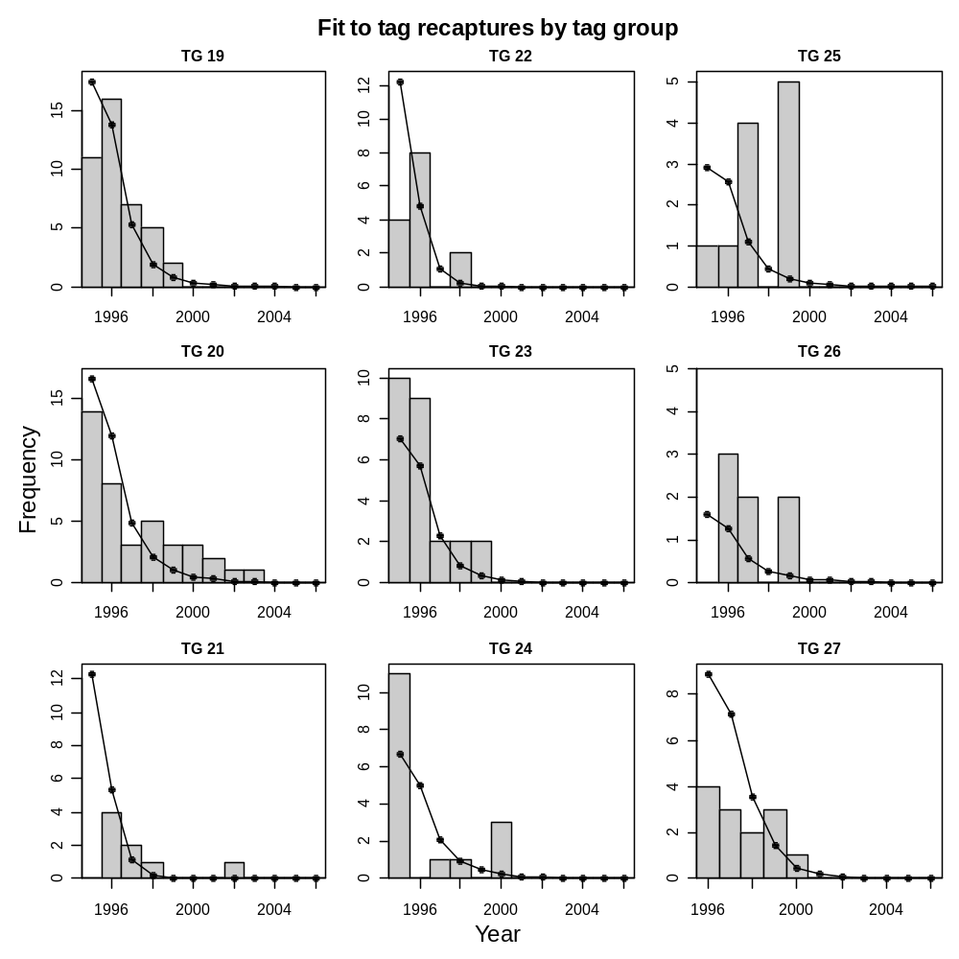
Example of observed and expected recaptures by tag group

